Slide 1


Information & Communication Technologies
Cyber Security Should Not Be Your Concern

Slide 2

ABOUT US.
Our aim is to make new initiatives together with our country's talented software developers who are making efforts to develope software/hardware;
to develope and produce together,
to act by the "win-win principle",
to become a brand name in our region and then around the world.

Slide 3










Cyber Security Should Not Be Your Concern
OUR PRODUCTS ​

Slide 4




www.cyspot.com.tr

Slide 5



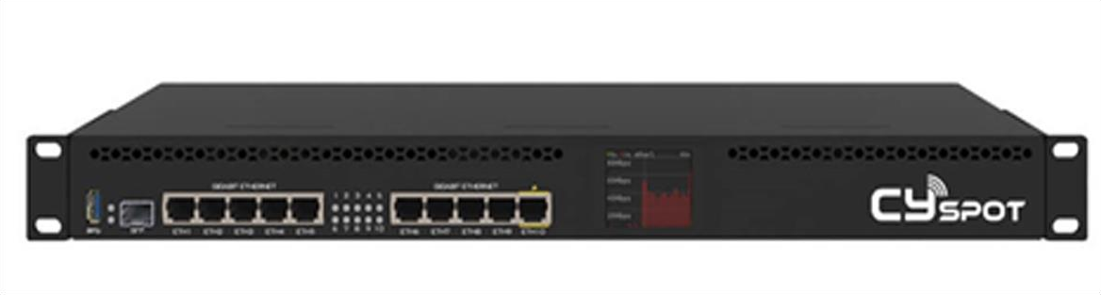

CySPOT Cloud Hotspot
CYSPOT, CYSPOT is a cloud-based hotspot and firewall software product that helps you provide your guests and customers with wired and wireless network access. Using CYSPOT, you can authorize your visitors, customers, and employees.

Slide 6
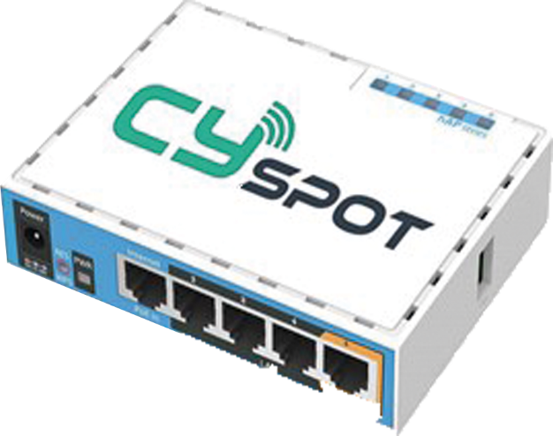
CySPOT Cloud Hotspot
You can set up a paid or free access infrastructure for your network and log any action taken within the network. CYSPOT, which enables authorization of users with the welcome page when they are connected to the network, offers an authentication infrastructure with Republic of Turkey Identity Number, Phone Number, or Social Media Accounts.

Slide 7




Law No. 5651
Pursuant to Law No. 5651
The records to be kept will be kept on the cloud for as long as the legal obligation period and can be easily accessed from anywhere when needed.
According to the Wi-Fi Risk report published by Norton in June 2016, on Public Wi-Fi networks, 22% of users use banking applications, 56% visit social media accounts, 38% share photos or videos, and 58% access their e-mail accounts.

Slide 8








WHY CySPOT?
Flexibility and Efficiency
Capacity increase and decrease can be done easily according to demand. You can determine how your infrastructure is used, through your special management panel.
Fast Feedback
Location-Independent Management
CySPOT enables companies to manage all the control from the servers on the cloud by providing the hotspot service they need with cost-effective devices over the CySPOT Cloud Platform, instead of installing costly devices within their own structure. Thus, it can minimize maintenance, repair and execution costs.
You can manage your points with CYSPOT infrastructure from a single interface. Push Notifications We send automatic notifications in case of an undesired situation (device failure, misuse, limit excess, etc.) One-Click Action In case of any undesired situation, you can prevent such operations as remote desktop connection, VPN, and upload with a single click.

Slide 9


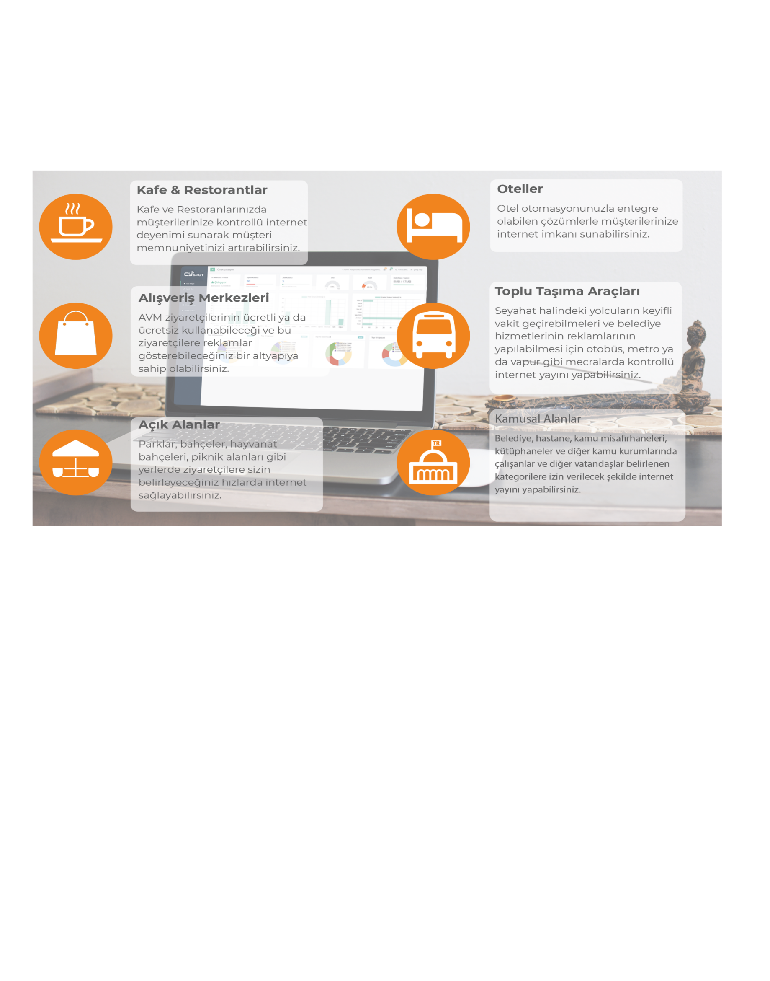
Advantages of Cloud Wi-Fi
By choosing the CySPOT Cloud Hotspot infrastructure, you can rest comfortably on your seat thanks to low cost, background updates, unlimited storage and self-made security measures.

Slide 10

CySPOT for Generation z
"Internet Usage" is one of the most important technologies used by the Z generation in their daily life.
3 out of 5 young people in Turkey have regular internet access
Generation Z, who dedicates an average of 330 minutes a day to internet use, has to choose the operators that are most suitable for their budget. Those who do not want to take advantage of this high-cost service provide internet access from free hotspot points.

Slide 11




CySPOT for Parks and Gardens
By offering CySPOT Hotspot service in public or private areas such as parks and gardens, you can appeal to any user who wants to connect to the internet.
A Great Option for Private Surveys
Audience-specific Advertising
With CySPOT, you can create custom surveys for target audiences that have the potential to connect to your network and get real feedback.
You can show the ads you want to users connecting to your network, and present them in the most effective way.

Slide 12







Why Us?
ID number, SMS, Social Media Accounts and E-Mail Address options are offered to be included in the network.
Bandwidth of users
can limit, the site they can go to or
You can also specify site categories.
1
In addition to the advantage of fast and easy installation, you can easily manage the system with a user-friendly interface on the administration side. You can show ads to the desired group at certain time intervals among the users included in the network.
7
2
In case of need, all devices included in the internet network
information, records of users and the internet of these users.
usage statistics and all other records
You can see detailed reports.
You can provide a personalized welcome screen, personalized arrangements for the visitor's device language, such as page flow, setting an agreement that must be accepted if the network is used.
6
3
Time/quota based limits on users if requested
you can put If these limits are exceeded, lower
You can switch to speed limit profile or pay for time/quota increase.
you can redirect to your page.
5
4
By purchasing more than one internet subscription, you can offer uninterrupted internet to your users. You can get a quick solution for your malfunction and other needs by getting hardware or software support from us.

Slide 13


Slide 14
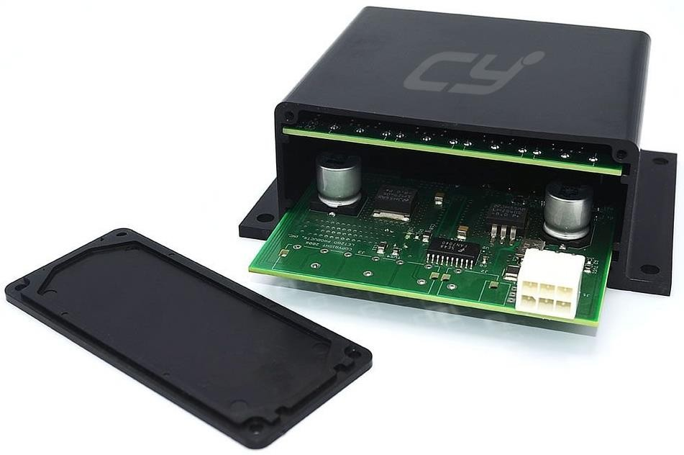



CySENSE Nedir?
CYSENSE is designed to be used in such areas as system control rooms, network rooms, data centers, cold storage rooms, where values like temperature, humidity, smoke, leakage, air quality, and door lock can be checked through various sensors.

Slide 15








Neden CySENSE?
CYSENSE sensors with ideal dimensions communicate with IP addresses over computer networks and can be powered by Poe Switch Port or an external power supply.
You can make various configurations, receive reports, generate alarms, and authorize your personnel at different levels of responsibility within the CYSENSE software running on the hardware that we developed especially for this purpose.
You can see all the information collected by all CYSENSE Devices connected to the system as well as all instant and historical data in our user-friendly interface. The Linux server on which this interface will be installed can run on standard physical and virtual servers.

Slide 16
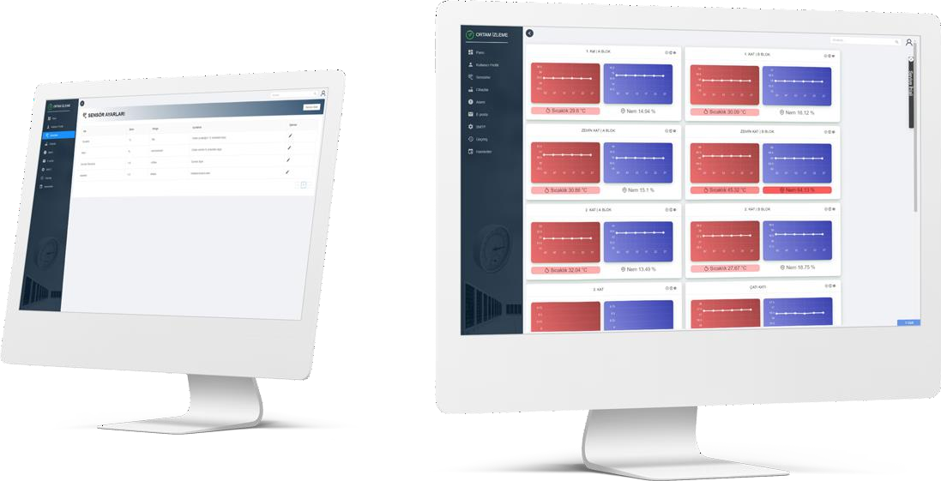

A certain number of sensors in total can be added to CYSENSE, such as temperature, humidity, smoke, water leakage, air quality, oxygen, carbon monoxide, and door sensors.

Slide 17

www.cydefender.com
An Amazing Solution to All Malware

Slide 18






What is CyDEFENDER?
CYDEFENDER actively scans all modified files within user accounts in the background regardless of how they are installed.
Active scanning of files helps prevent an account from being exploited by malware by deleting or quarantining suspicious files before they activate.
It can also prevent the upload of scripts, which are used to launch malicious attacks and send spam, from PHP, Perl, and many other extensions.
CYDEFENDER allows for comprehensive and continuous scanning of all user information in the background and instantly notices when any user file is changed,

Slide 19



What Does CyDEFENDER Do?
CyDEFENDER Keeps your server safe by scanning your servers regularly.
It monitors files and indices when there is any change. It sends instant SMS and email notifications in case of change,
It minimizes server risks by scanning thousands of web shells and malicious exploits.
CyDEFENDERTested and approved by certified experts.

Slide 20





Get instant notifications about suspicious files entering your server while roaming.
It prevents any exploit infecting your server from spreading to your network.
CyDEFENDER protects the databases on the server from malicious software.

Slide 21




Web Shell and other malware can hijack your server. Stay safe with CyDEFENDER.
CyDEFENDER detects suspicious files even if they are encrypted.
CyDEFENDER maximizes your security by scanning thousands of Web Shells and malicious exploits.

Slide 22






Supported Platforms

Slide 23

www.cynetconfig.com
Network Devices Setup Management Software

Slide 24

What is CyNetConfig?
Organizations use various software products to back up and configure the devices within network and security systems.
However, most of these solutions do not support the basic devices that constitute the network, such as firewall, router, switch, and load balancer, at the same time. This situation causes the need for a different administration panel for each device and process management that is far from integrity.
Today, it is critical for organizations to manage their setup logs and to access these logs safely and quickly when needed. Otherwise, business processes can be interrupted due to network outages and compliance errors, which can result in financial loss and loss of prestige for companies.
The product that meets this need independently from the brand and centrally is CYNETCONFIG.

Slide 25




What Does CyNetConfig Do?
Central setup management for network devices of different brands/models
Backup of settings and restore from backups in case of a crisis
User authorization and access control
Direct end-to-end access

Slide 26

Easy Restore
In case it is needed, you can easily restore your setup logs of the products of the following brands to your devices with a single click.
AutoBackup
With its advanced operation timer, you can automatically back up the configuration and backup logs of your network devices on a monthly, weekly, daily, and hourly basis.

Slide 27

Monitoring Interface
• CyNetConfig allows you to view the availability of all devices in your network infrastructure, setting backups, inventory information records and all these processes with statistical information.

Slide 28
Easy Management
CyNetConfig, user-friendly web interface and network simplifies the settings backup processes of your devices
Uploading settings to many of your network devices at the same moment is time saving.
You can restore to your previous settings with the versioning feature.

Slide 29
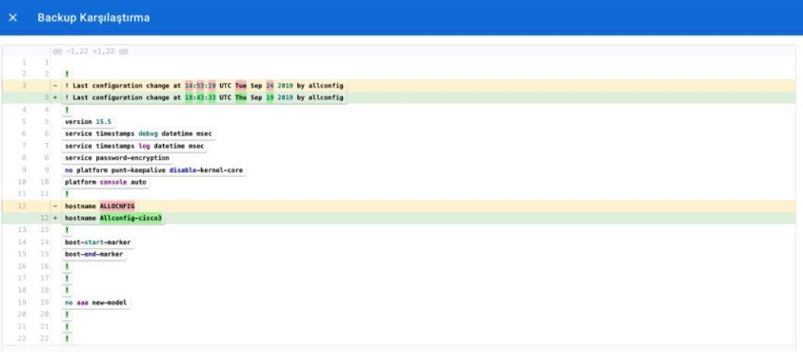
Setting Comparison

Slide 30
Direct Terminal Access
• You can open a terminal directly with the user information you have entered on your device.
You can also restrict who can access which device.

Slide 31









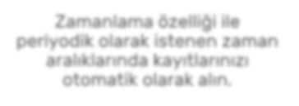

Export
Export your backups to a server in a different location with the export feature.
With the scheduling feature, get your records automatically at the desired time intervals periodically.

Slide 32
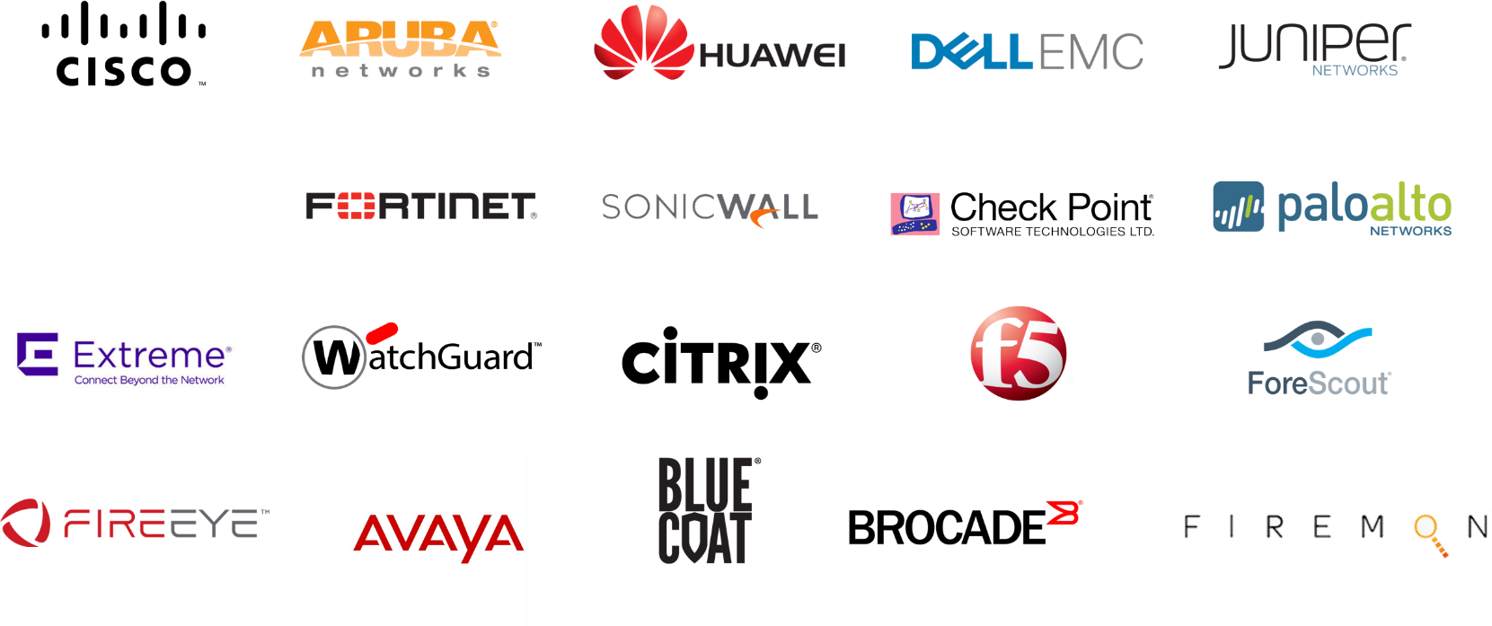
Supported Platforms

Slide 34



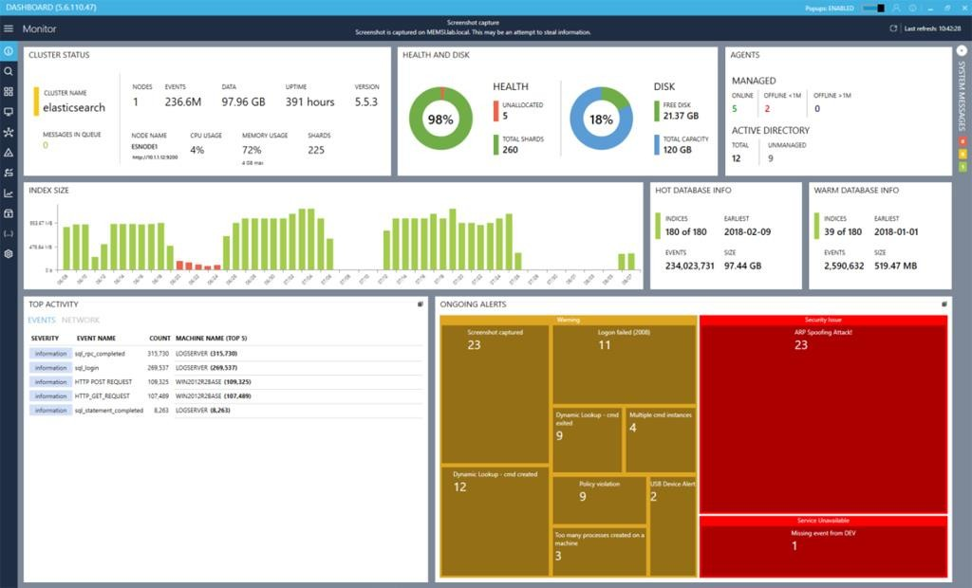

WHAT IS CyThreat SIEM?
CYLOG SIEM is a log management and alert (SIEM) product that lets you centrally collect logs created by laptops, desktops, servers (Windows, Unix, Linux, etc.), network devices, application servers, firewalls, and any other system within your organization and receive real-time alerts from these logs.
CYLOG SIEM includes all the functions of a SIEM product while it can also be used to increase the effectiveness of the SIEM product available in your organization.

Slide 35






Why CYLOG SIEM?
Easy Conformity to Security Audits
It helps you meet the control requirements in accordance with ISO 27001, PCI, SOX, COBIT, and similar security standards and procedures.
Customizable Dashboards
CYLOG SIEM is provided with numerous ready-made dashboards, but it is possible for users to prepare their own dashboards and share them within the organization.
Fast Response in Criminal Investigations
Responding to a request from the prosecutor's office or relevant authorities on the grounds that an event on your corporate computers is connected to a recent forensic investigation is important for the protection of your corporate identity.
Protection of Your Commercial Value
It allows you to proactively detect when sensitive information, patient records, personal information of your personnel, customer documents and records, and information and documents of commercial importance are shared with other organizations and persons and/or to develop the necessary methods to take proactive measures against such events.
Proactive Intervention: Security breaches do not happen all of a sudden. With the analyses of the events that occur before the breach, such situations can be detected in advance. For example, an employee who is about to leave the company can back up their files, compresses them, and copies them to the cloud or a USB storage device. With CYLOG SIEM, you can detect such events in advance.

Slide 36

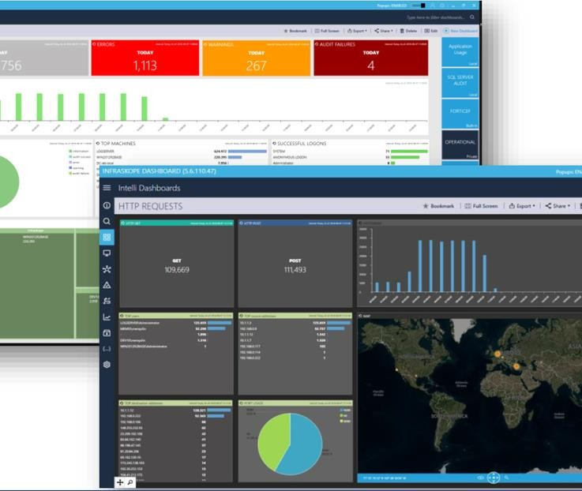


It is installed and available to use in a short time
Detection of synthetic (off-record) events
With its micro agent, it detects not only the events reported by the operating system but also the events that can cause a security breach: For example, files copied to USB devices, records of system administrators' access to user computers, and many similar events are not recorded by the operating system. CYLOG SIEM Agent monitors and records such and similar events.
CYLOG SIEM installation is completed in only a few hours. Agents are deployed to user and server systems in silence with Active Directory or a software product used for this purpose. In this way, you start collecting information the next day.
Easy integration with systems in your server park
With CYLOG SIEM Server, you can also collect the logs of other products in your data center. CYLOG SIEM lets you easily monitor the events that occur on your Linux operating systems, network devices, databases, and application servers.
You get fast results with available warning rules
Corporate software and hardware inventory
CYLOG SIEM Server has been used in many organizations and companies since 2005. Improvements from these experiences are built into the product with every CYLOG SIEM installation. Thanks to this cycle, you immediately start benefitting from current threats, warnings, and reports.
With the detailed software and hardware inventory collected by CYLOG SIEM agents, you can obtain information about all the software and hardware within your organization and plan your hardware and software updates based on this information..

Slide 37







Product Features
Notifying the system administration through various methods (SMS, email, application execution, images) when a critical event occurs.
Ability to build a correlation between different events
Proactively notifying you of failures (disk failures) that may occur in your user computers.

Slide 38

Examples of events that can be monitored by collectors
Logs of sent/received emails,
Access logs of firewalls and active network devices,
Collection of access and operational logs of critical applications (SAP, SQL Server, Oracle, Exchange Server, etc.),
Collection of Web/FTP/SMTP and internet service server logs,
· The resources supported by Collector Framework are listed below:
EventLog,
Logs based on text file (W3C, IIS, LOG, CSV, TXT, TSV, v.s.)
Syslog (UDP and TCP),
OPSEC LEA (Checkpoint),
Database (MSSQL, ORACLE, MYSQL, ODBC and others),
Special systems (special log collection method based on the product).

Slide 39

Examples of events that can be detected by agents
· Tracking of access (without notice) to machines by system administrators,
Usage of hacking applications (Wireshark, Cain&Abel, Nessus, etc.),
· Detection of hardware keylogger devices,
· Detection of network monitoring events,
.Tracking of indices open to sharing,
.Identification of the machines creating the most network traffic,
Kullanıcı bilgisayarlarına yapılan saldırılar (şifre kırma vb.),
Attacks against user computers (password cracking etc.),
Identification of advanced password cracking methods (KONBOOT, ERDCommander, etc.),
Detection of any device attached to user computers,

Slide 41
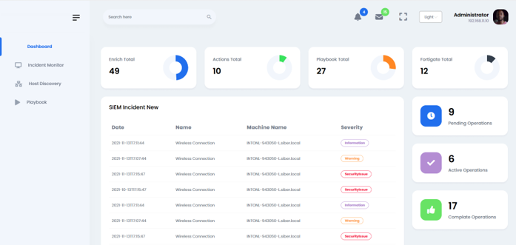




Why CyThreat SOAR?
CyThreat SOAR has three main components:
security regulation
Security automation
Security response.
SIEM Aksiyon Değer Katar

Slide 42

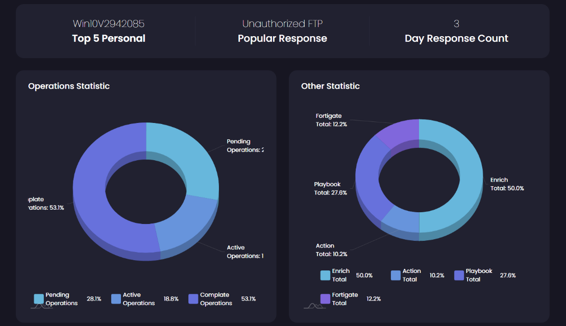
Manage Security Operations in One Platform
Check Your Future Wealth
The SOAR platform should help improve security operation:
these
SIEM INTEGRATION
Easy setup
Goal-oriented

Slide 44



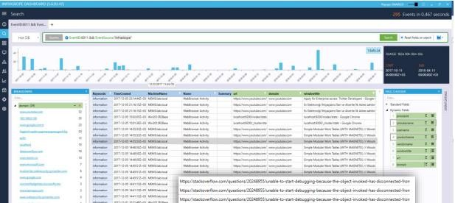
WHAT IS CyThreat APP TRACKER?
It records which user actively uses which application and for how long in user and server systems.

Slide 45




CyThreat APP TRACKER
CYLOG APP TRACKER is designed in response to three basic questions:
“
Internet usage without the use of a corporate firewall,
Efficiency.
“Active” application usage metrics,

Slide 46







Are You Using Applications Efficiently?
Many applications like Microsoft Office, VMWare, Petrel, AutoCAD, Adobe, etc. are requested by users, and hence, companies pay considerable amounts for licenses.
But are these applications used efficiently for real? AppTracker allows you to obtain the necessary logs so that you can easily answer this question.

Slide 47

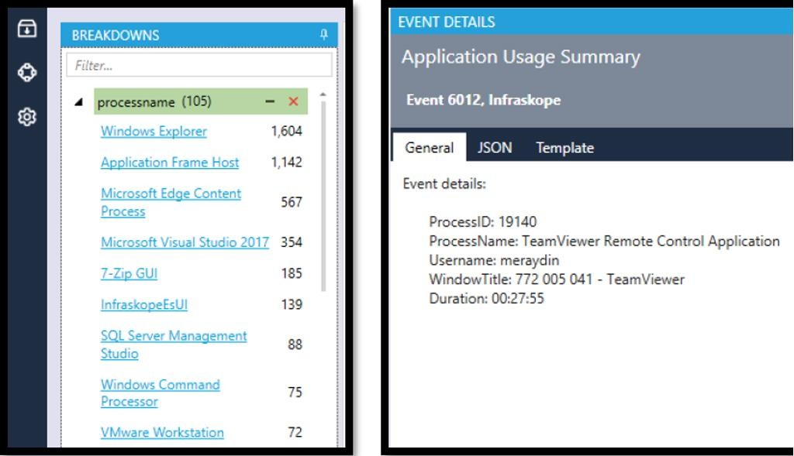


CyThreat APP TRACKER
Summary Usage:
When a user locks or logs out of their computer, summary records are created for the applications used so far.
This information allows you to generate reports on the efficiency of the person and at the same time, which application is needed to what degree.
Detailed Usage:
CyThreat APP TRACKER measures how much a particular application is actively used. It does not consider an application minimized to the taskbar as actively used. Thus, it helps you see the actual usage time.

Slide 48


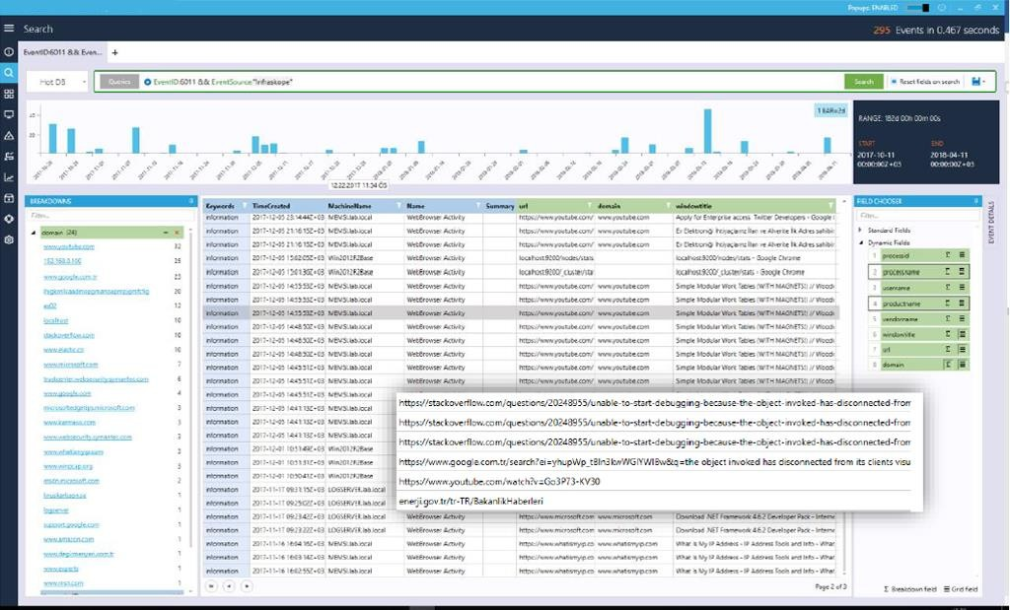
CyThreat APP TRACKER
Internet visits without using a corporate firewall
The ease of use of mobile phones and wireless networks allows some users to visit the sites they want without using the firewall and not be affected by the restrictions.
Once you turn your mobile phone into a USB, Bluetooth, or wireless access point, your activities cannot be logged.
CyThreat App Tracker addresses these scenarios and logs the connections made.

Slide 49

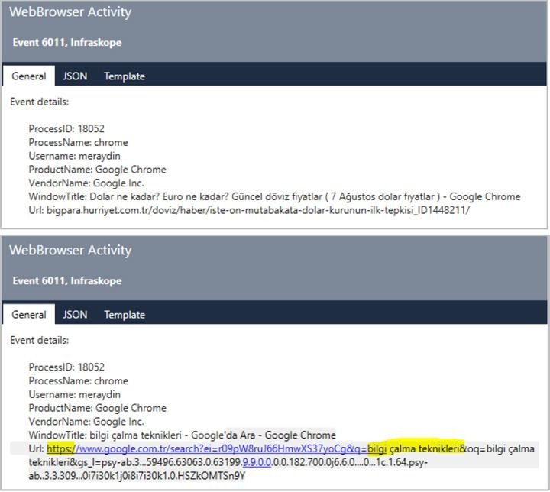
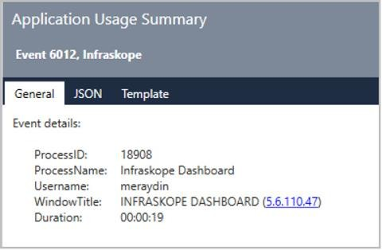
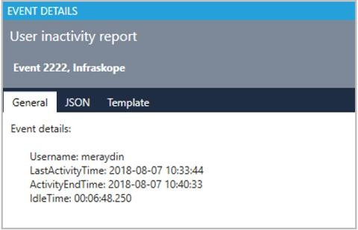
Events Detected with CyThreat AppTracker
Without using the firewall (mobile
Phone,non-corporate
wireless access point, etc.)
internet connection (http/https)
tracking of addresses
Tracking application usage and times
CYLOG APP TRACKER measures the time during which users are not using their computers as well.

Slide 51

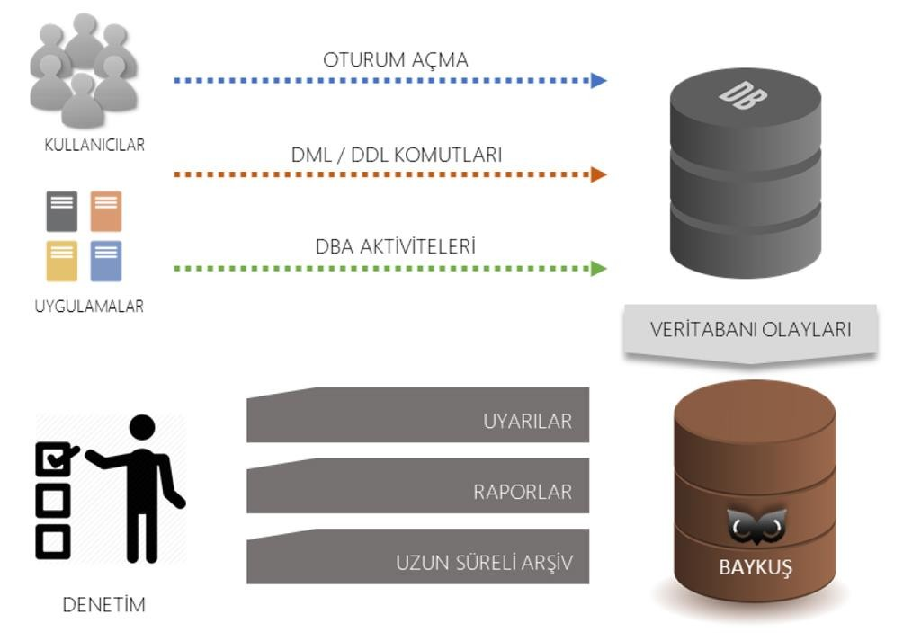
CyThreat DATASKOPE
CYLOG DATA SKOPE,is a Database Event Audit and Access Monitoring product.
The main purpose of the CYLOG DATA SKOPE Database Audit product is to ensure that accesses and changes to critical database systems are as expected, planned, and desired.
You can perform all these actions without turning on the audit feature within the database.

Slide 52






What Does CyThreat DATASKOPE Do?
Login
It lets you track successful and failed login attempts made in the database.
Data Content Change
It enables the tracking of such commands as SELECT, UPDATE, DELETE, or EXEC.
Access Tracking
It enables the tracking of such commands as SELECT, UPDATE, DELETE, or EXEC.
Reporting
It lets you obtain reports conforming to such standards as ISO27001, COBIT, PCI, and SOX.
Database Administrator It tracks such activities as user creation, deletion, etc. and allows you to take action.
Classified Control
It allows you to decide who can view the activities on the level of user, database, table, and command.

Slide 53







Supported Databases and Operating Systems:
· SQL Server 2008 R2 and higher versions · Oracle 11g ve üstü (ExaData/TeraData including) · ElasticSearch 5 and higher versions · MySQL (2019 Q1) · PostgreSQL (2019 Q1) · Hadoop (2019 Q1) · DB/2 (2019 Q1) · Windows 2008 R2+ · RedHat EL5, EL6, EL7 · Oracle Linux EL6, EL7 · SUSE Enterprise Linux · Solaris 11+

Slide 55





CyTHREAT SCREEN RECORDER PRODUCT FEATURES:
In the simplest sense, CYLOG SCREEN RECORDER can be compared to a security camera built into each computer/server.
It records every activity made on your computers and servers in video format.
11
It lets you monitor these activities in real-time or retrospectively.

Slide 56

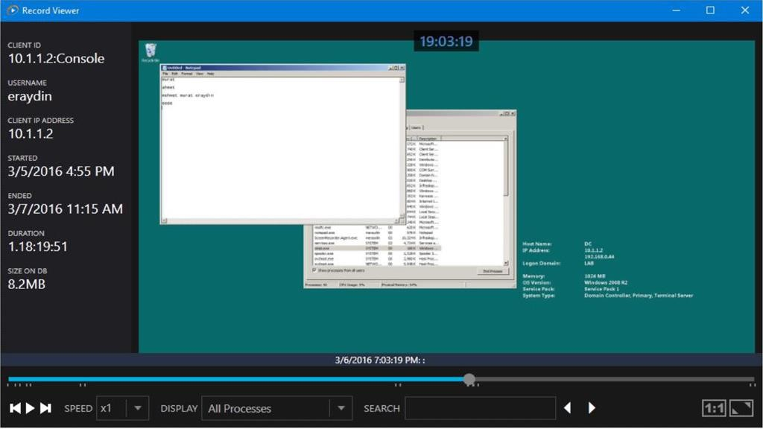
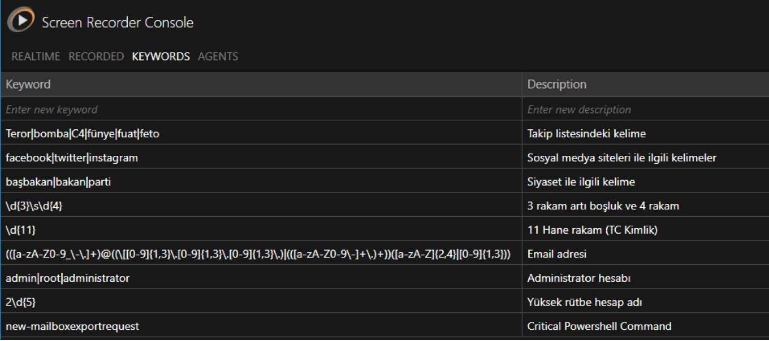
CyTHREAT SCREEN RECORDER PRODUCT FEATURES:
Features:
· Visually recording the local and remote connection sessions of the systems including critical information,
· Logging the users that can access critical information regardless of the machine they use to log in,
Creating warnings for critical words or phrases that are predefined (email, Republic of Turkey Identity Number, etc.),
Ability to search for the sessions where critical words are used,
Ability to pinpoint the moment where the critical word within a single session,
Ability to play sessions up to 32 times faster.

Slide 57


Slide 58


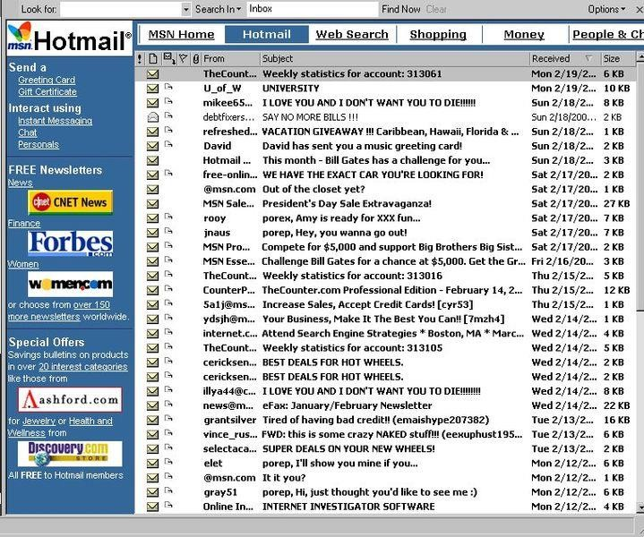


E-MAIL 1.0
The Story of the Last 30 Years
CyMAIL, especially with foreign service providers that have been in the Turkish e-mail market for a long time,It offers more than the features offered by domestic providers.

Slide 59
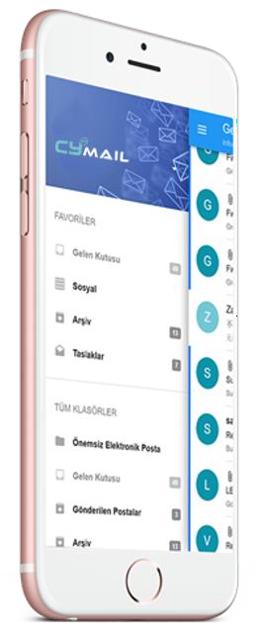


2.0 The E-mail Standard of the Future
CYMAIL, which includes such services as almost unlimited email storage capacity, end-to-end encryption supported by SSL/TSL security protocols, DNS Record Management, WHOIS hide service, and domain parking for free, is an advanced email service that lets you manage all your domains and user accounts on a single screen through the admin console.

Slide 60





PROBLEM
Bosses do not want external emails to be sent unchecked!
SOLUTION
Admin Approved Email Submissions

Slide 61

PROBLEM
Reservation/appointment processes waste time
SOLUTION
e-mail accounts that
have artificial intelligence and can communicate with people

Slide 62







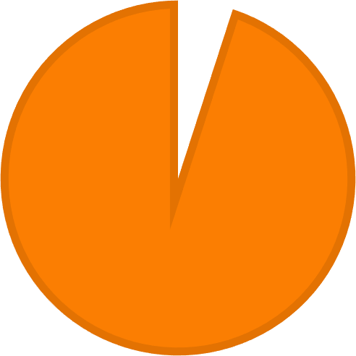
MARKET VOLUME
Email Marketing In Turkey
(VOLUME: 80 MILLION ACCOUNTS)
Hotmail (%54) Gmail (%36) Yahoo (%3)
Other (%7)
Subscription Distribution
Professional/Paid Email (Premium)
Free Email(Freemium)
7%
3%
5%
36%
54%
95%

Slide 63

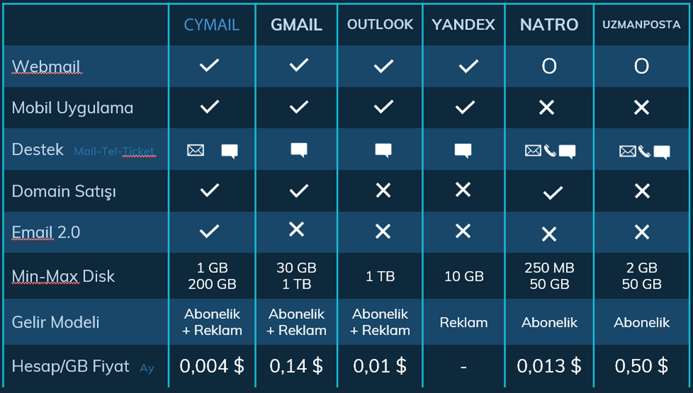
MARKET VOLUME

Slide 64



WHY CyMAIL?
E-mail service that produces its own technology
Market leader developed by the companys brainteam
High market volume
Turkey's first and only domestic SaaS e-mail service.
Government incentives
opportunities

Slide 65

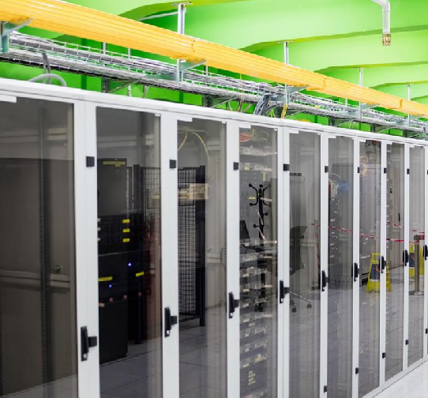


OUR SERVICES
Project-Based Software Development
Data Center
System Integration and Installation
System and Software Optimization

Slide 66

REGARDS
www.cypoint.com.tr

